Slide 1
Lung Cancer Detection
using Image Processing
on CT Scan Images
By: Leong Shu Ling (26546981) & Moana Yamanouchi (27742407)

Slide 2
Agenda
Introduction
Aims & Objectives
Methodology
Limitations & Discussions
Test Result Analysis & Demonstration
Individual Contribution

Slide 3
Introduction
Cancer: disease involving abnormal cell growth
Tumors
Benign: remains in same place
Malicious: spreads via bloodstream/lymphatic system (metastasis)
Small cell lung cancer (SCLC)
10 to 15%
Main cause: smoking
Non-small cell lung cancer (NSCLC)
85%
Report from American Cancer Society (2018)
About 234,030 new cases & 154,050 deaths
Early detection to increase recovery rate

Slide 4
Aims & Objectives
Aim: Obtain high quality image at an early stage to accurately classify between normal and abnormal lung in a CT scan using MATLAB
Objective:
Critically analyse various image processing techniques for each stage of pre-processing, segmentation, and extraction
Evaluate which techniques is the most suitable and effective for each stage of pre-processing, segmentation, and extraction
Extract CT images from Lung Image Database Consortium Image Collection (LIDC-IDRI) dataset
Design and develop a system that produces accurate results by correctly applying the algorithms in MATLAB
To make recommendation for further improvement for future scope to give more accurate result for lung cancer detection, if necessary

Slide 5
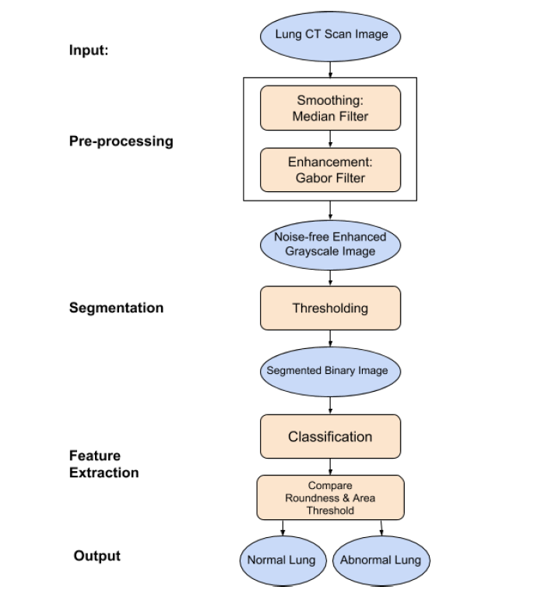
Methodology

Slide 6
Pre-process: Smoothing
Median Filter
Reason of choice:
Produce high spatial frequency
Sufficient noise reduction capabilities
Idea:
Replace pixel value with median value of the neighborhood
Process:
medfilt

Slide 7
Pre-process: Enhancement
Gabor Filter
Reason of choice:
Responds to edges and textures
Optimal localization properties in both spatial & frequency domain
Idea:
Improve interpretability or perception of the image
Process:
imgaborfilt

Slide 8
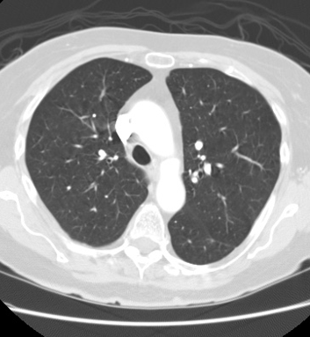
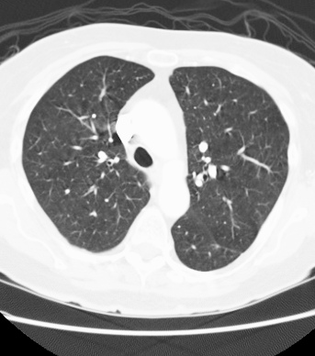
Enhancement: Gabor Filter

Slide 9
Segmentation: Thresholding
Reason of choice:
Faster processing speed
Lesser storage space requirement
Idea:
To separate objects from background
Using Otsu’s method - select threshold that minimize within-class variance and maximize between-class variance
Process:
imbinarize

Slide 10
Classification
Set area threshold (100) and roundness metric (0.25)
Detect 5 largest objects which are the potential nodules
Compare with the threshold values
if the object meets all conditions:
Abnormal Lung
else:
Normal Lung

Slide 11
Test Result Analysis & Demonstration
Total images = 69 (39 for cancer CT scan; 30 for normal CT scan)
Accuracy of system = 56/69 * 100% = 81.2%
Rate of Measurement | TAR | TRR | FAR | FRR
Images | 32 | 24 | 6 | 7

Slide 12
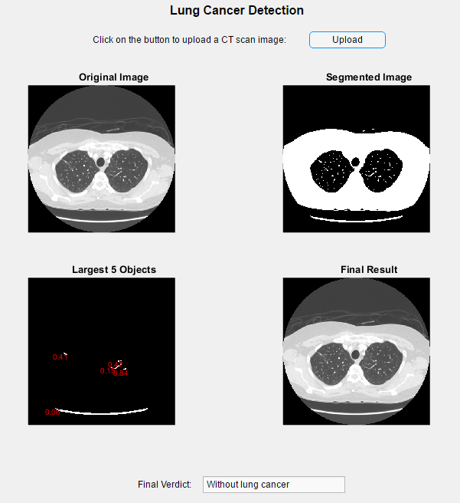
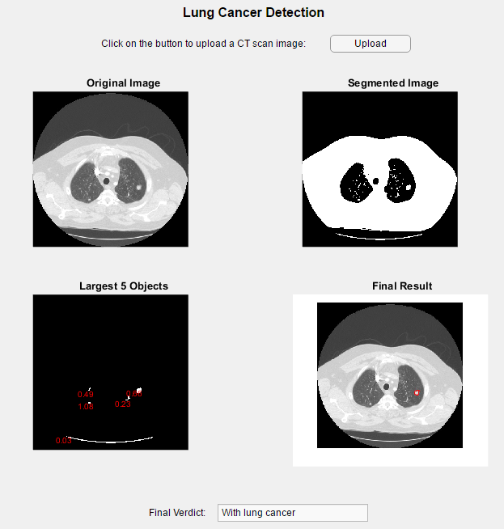
Demonstration

Slide 13
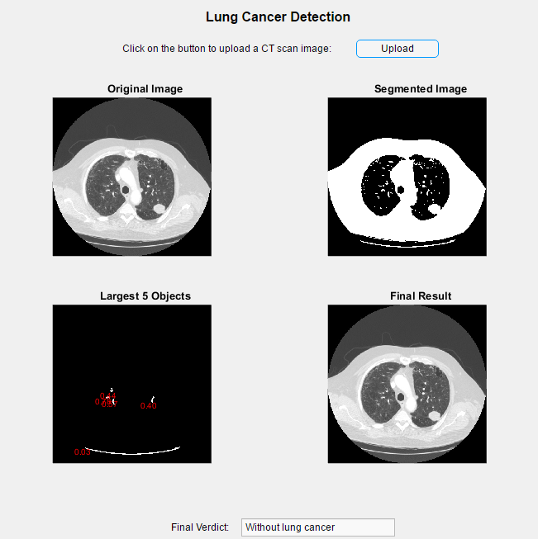
Limitation & Discussion
Various types of noises
Median filter -> reduce salt & pepper
Classification
Tumor near the border

Slide 14
Improvements
Can implement stages of lung cancer
Stages I to IV
Stage I : cancer confined to the lung
Stage II & III : cancer confined to the chest
Stage IV: cancer has spread from chest to other parts of the body
Calculate based on Area, Perimeter & Eccentricity

Slide 15
Individual Contribution
Moana:
-Smoothing
-Enhancement
Shu Ling:
-Feature Extraction
-Segmentation
Objective (compressed):
Critically analyse various image processing techniques
Evaluate techniques
Extract CT images from database
Design and develop a system that produces accurate results
Recommendation

